Slide 1
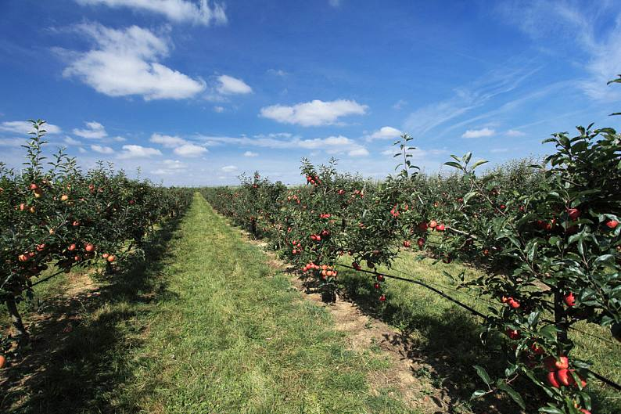



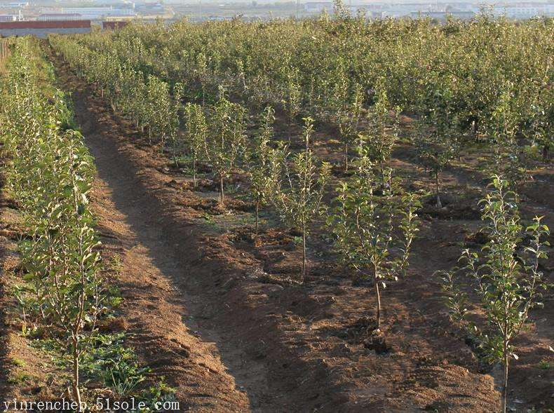
Information strategy
Impact
Technology adoption
Gender
Age
Education level
Training
Identity
Farm cooperative
which information
source(s) do you use
when you decide which
fungicide product to use
?
Agri-chemical
dealer
New technology
Obviously improved
apple farmers`
Crop protection
Agricultural
Technology
Extension
Service
center
Dwarf cultivation
Local expert
Impact
Farm
cooperatives
Farmer
Orchard
Management decision
Farmer peers
Mass media
New technology
less obviously improved
apple farmers`
economic return
Planting area
Tree age
Disease
Pest
which information
sources do you refer to
when you decide the
dosage and application
timing?
Personal
experience
Virus-free seedlings

Slide 2



Information strategy
Implication
Farmer
Extension Staff
Economic benefits of new technologies are critical for acceptance of new technology.
Precise directions for technology extension and the cautions needing to be taken.
Management decisions
Management effect
Adoption decisions

